Slide 1
Unsupervised Text Segmentation
Experiment

Slide 2
thecatwasoldandhappy

Slide 3
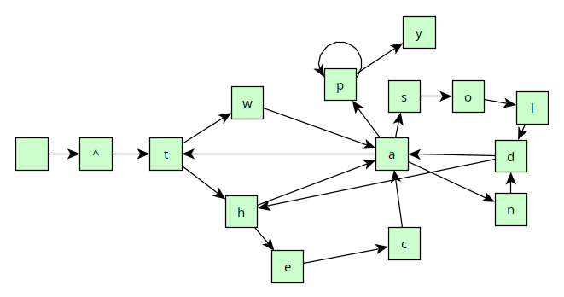

Slide 4
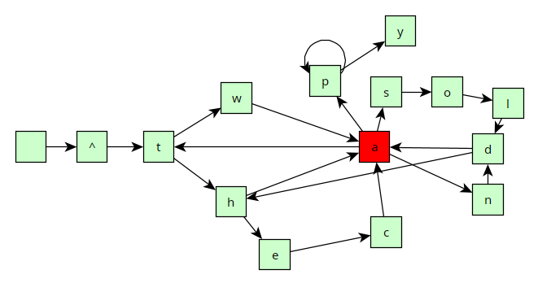

Slide 5
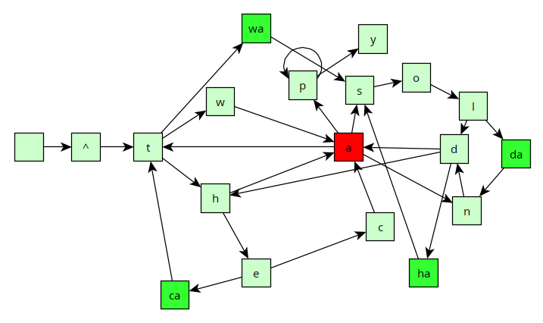

Slide 6
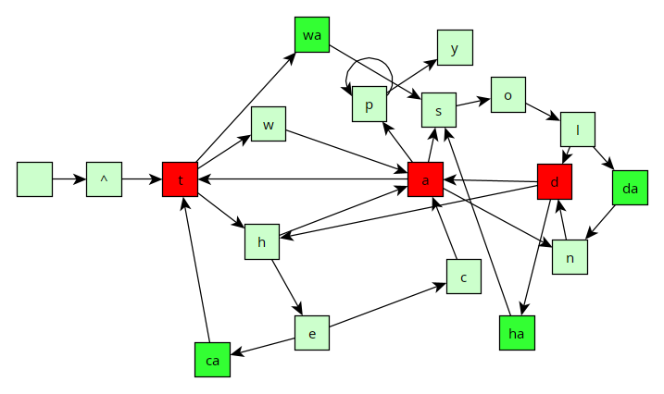

Slide 7
